Slide 1


Slide 2

Welcome! Agenda for Today
Morning
Welcome, Opening Remarks and Updates
Lunch 12:15 – 1:00 (Wall Scrolls)
Afternoon
Panel Presentation
Wrap Up
Exhibit Table Conversations
POTJ Website
Outreach - Table Conversations
Strategic Planning 2023-2025
Share Thoughts on Wall Scrolls
Share Thoughts on Wall Scrolls
Morning
  Welcome, Opening Activities
  Storytelling by Dr. Neil Bardhan & Danielle Marino
  Lunch 12:00 – 12:30
Afternoon
  Big Picture: Current Strategic Plan (PATH) and Infographic
  Workgroup Brainstorming and Planning
  Report Out
  Wrap Up

Slide 3

Notes:
Why is this significant?
NDEAM, celebrated every October, emphasizes the critical contributions of America’s workers with disabilities. It's an occasion to promote inclusive employment policies and practices benefiting both employers and employees. For NDEAM 2023, the Office of Disability Employment Policy (ODEP) has chosen "Advancing Access and Equity" as the theme.

Slide 4
Employment First Stakeholder Meeting
~ ODP ~
10/19/23

Slide 5
Selective Contracting
Residential Strategic Thinking Group drafted performance measures
Residential provider survey published 10/11/23 Purpose to gather baseline data and inform pay for performance models
ODP residential providers need to complete
Survey open for 30 days
Supports Coordination Strategic Thinking Group ODP is finalizing membership
Meetings to begin in December
Will draft SCO performance measures

Slide 6
Selective Contracting
Selective Contracting Public Comment
Selective Contracting Concept Paper public comment period ended 7/10/2023
Comments received from approximately 311 commentators
Proposed Waiver and Waiver Amendments for Public Comment: ODP will publish the 1915(b)(4) application and any accompanying 1915(c) amendments for public comment prior to submitting to CMS

Slide 7
Public Comment
Public Comment
Approximately 311 Commenters
Key Themes
Finance (91 mentions)Payment design consideration for Value-Based Purchasing (VBP)/cash flow
Review of rate methodology for SCO model
Outline components paid for within the rates and components (reporting and/or quality) measures paid in addition to rates (Pay for Performance)
Workforce (87 mentions)Preferred organizations and benchmarks for credentialing
Definition of clinical team
Overall concern with DSP wages and that selective contracting will not solve workforce issues

Slide 8
Public Comment (cont.)
Public Comment Feedback (cont.)
Key Themes
Timing of Implementation (51 mentions)Opportunity for public comment
Pilot program/slow down
SCO before residential
Further description of roll-out process and expectations needed
Quality (134 mentions)Agency or recognized credential for SC
Turnover of contracted DSPs
What is definition of quality
Further definition of measures
Inclusion of social justice standards

Slide 9
Themes
Key Themes
Impacts on Participants (56 mentions)
What if individual’s provider is not preferred
Consideration for individual and family engagement
Access (76 mentions )
Define service area
Providers already limited; Choice further limited if requirements increased

Slide 10
Themes cont.
Key Themes
Residential and SCO Criteria (270 mentions)
General comments on disproportionate impact on small providers, particularly with continuum of services as preferred criteria
Model (78 mentions )
Further descriptions of standards, measures, and tiers needed
Further definition of AEV role

Slide 11
Updates to Selective Contracting Proposal
Timeline Adjusted –Residential implementation January 1, 2025
Preferred Tier –Two Paths to Obtain Preferred Status
  2 of 3 Services Provided During the Review Period
  Meet Clinically Enhanced Standards
Workforce
  Credentialing will not apply to Lifesharing
  Front-line supervisors added to turnover standards
Details Added to Standards, Measures, and Tiers
Name change for data analytics vendor to “Performance Analysis Services”
Added performance standards
  Community Integration
  Participant Involvement in Advisory and/or Boards
  Cultural Competency
  Wellness activities

Slide 12
Employment
Performance Area - Employment — rate of competitive integrated employment (CIE) for working age participants, adjusted for acuity
Definition - Demonstrated support of individuals to seek and obtain competitive integrated employment (CIE).
All providers –
Demonstrate tracking of CIE and percentage of working age people with CIE.
Plan for improvement of CIE.
Select providers -
Combined XX% of working age individuals that are receiving Career Assessment or Job Finding services through ODP or OVR and
  competitively employed in integrated settings (working age participants only and adjusted for acuity)

Slide 13
ID/A and Adult Autism Waiver Amendments
Submitted to CMS 7/25/23
Remainder of unwinding from Appendix K flexibilities
Specialty Telehealth and Assessment Teams (ID/A only)
Addition of NG 5 (ID/A only)
Group Music, Art, & Equine therapy (ID/A only)

Slide 14
Employment 1st Stakeholder
Strategic Planning Event
Thursday, October 19, 2023
10:00 a.m. - 3:00 p.m.
The Liberty View at the Independence Center
Philadelphia, PA
OVR Updates

Slide 15
OVR Statewide Initiatives
Rapid Engagement
Pre-Employment Transition Services (Pre-ETS)
  MyWorks
  Youth Ambassadors/Youth Engagement Specialists- Natasha
  Work-Based Learning Experiences
  Summer Academies
Section 511 Career Information Sessions
Staffing
  Rapid Hiring Events for VR Counselors/Social Workers/Early Reach Coordinators
InVEST Project/SWTCIE Grant
Pennsylvania Transition Partners: Pathways to Partnership Grant

Slide 16
PA InVEST Project
Integrated Vocational Engagement Support Team
Total amount of OVR’s grant award - $13,943,300.47
Time frame of grant - 10/1/22 to 9/30/27 (5 Years)

Slide 17
PA SWTCIE Grant-
Three Primary Components of Grant Project to move individuals earning Subminimum Wage To Competitive Integrated Employment:
  CIE Engagement- PA Family Network- Peer to Peer
  CIE Supports- Embedded within Businesses
  CIE Service/Resource Coordination- Integrated Resource Team (IRT) model to be used within 14c facilities (aka Sheltered Workshops)
Charting the LifeCourse (CtLC) Framework- Person Driven Planning model to be used throughout project

Slide 18
PA Transition Partners: Pathway to Partnership
Total amount of OVR’s grant award - $9,990,688.97
Time frame of grant - 10/1/23 to 9/30/28 (5 Years)
Pathways to Partnership will develop work-based learning opportunities and robust transition planning for students with disabilities, as well as opportunities for youth service professionals from OVR, ODP, Education, and Centers for Independent Living to participate in professional development.

Slide 19
PA Transition Partners: cont.
The three-component grant model includes:
  Pathways to Partnerships—Professional Development, Capacity Building and Training
    Professional development opportunities will be available to all partners on Charting the LifeCourse Framework and Transition Discoveries
  Pathways to Partnership—Transition Discoveries
  Pathways to Partnership—Work Based Learning Experiences
The primary goal of the grant is to build upon and expand the relationships among all youth services providers to support successful school to work transition outcomes for students with disabilities.

Slide 20

Youth Engagement Specialists (YES)
Natasha M. Fletcher
PaTTAN East

Slide 21
What is Youth Engagement?
Youth Engagement – an equitable access and opportunity for youth to participate in activities that are related to their schools, communities, and self.

Slide 22
What is Youth Leadership
Youth Leadership – when youth are a genuine part of the decision-making process, identifying and implementing projects of their choice, and gaining the knowledge and skills to better advance the development of their schools, communities, and self.

Slide 23
Areas of Focus
Youth Engagement looks different in different environments, and all of this is in service of the goal of Competitive Integrated Employment. Some areas to implement youth engagement are:
Student Led IEPs
Disability Awareness and Self Advocacy
Engagement in Transition Planning
Employment Supports and Outcomes

Slide 24
How to Continue the Conversation
Reach out via email or text
  Natasha Fletcher
  nfletcher@pattankop.net
  267-571-8164
Apply for supports:
https://supports.pattan.net

Slide 25

Where are We Now Around Employment? Let’s Talk Numbers!
Notes:
Diane and Charlotte

Slide 26
Current Status
Typically have data from 13 to 15 providers out of 19
Data for FY23 first quarter is from 14 providers
YOUR data matters!
Notes:
Diane

Slide 27
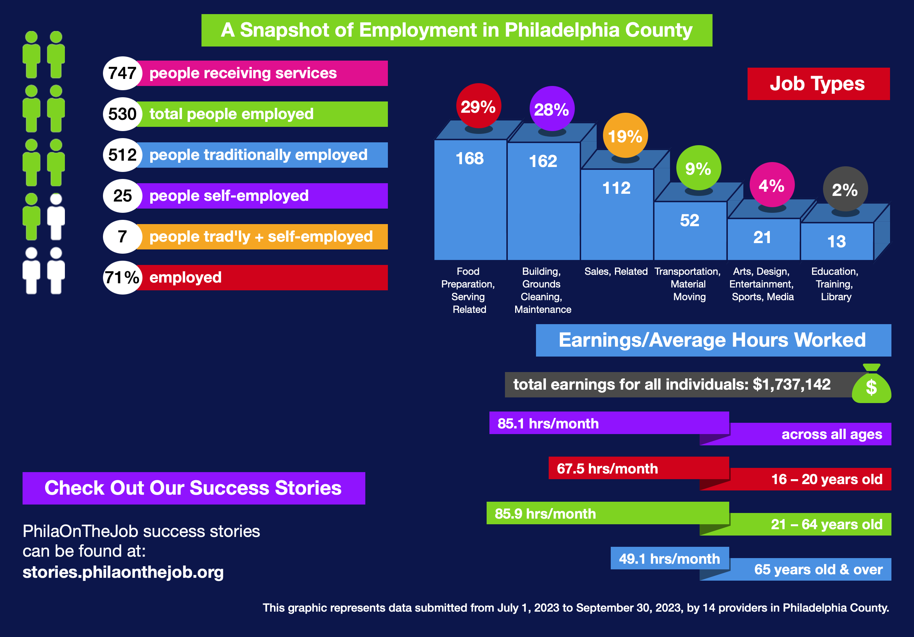
Employment First in Philadelphia: The Numbers (7/1/2023 – 9/30/2023)
Notes:
Diane

Slide 28
Comparison of 1st Qtr. 2023 and 1st Qtr 2024
1st Qrtr Fy22 (7/1/2021 – 9/30/21
1st Qrtr Fy23 (7/1/2022 – 9/30/22
789 people receiving services
522 total people employed
  570 jobs + 24 self-employed
66% employed
Earnings/Average Hours Worked
$1,533,286 total earnings for all individuals
83.6 hours/month
747 people receiving services
530 total people employed
  584 jobs + 25 self-employed
71% employed
Earnings/Average Hours Worked
$1,737,142 total earnings for all individuals
85.1 hours/month for workers across all ages
NOTE: at the time of the stakeholder meeting last year these numbers were dramatically different (by over 200).

Slide 29
Employment Outcomes: 7/1/2022 – 6/30/2023
Overall Stats
838 people received services
610 total people were employed
73% employed
Earnings/Average Hours Worked
$6,3115,267 total earnings
Avg. of 83.4 hours/month
Top Five Job Types
Building and Grounds Maintenance
Food Preparation and Serving
Sales and Retail
Transportation / Material Handling
Arts, Design, Entertainment, etc.

Slide 30
Reminder - Tiered System for Data Stipends
Outcomes
Percentage of data submitted rose from an average of 86% to an average of 89%
Increase from 7 providers submitting at least 95% of their data with an average of 100% in FY22 to 10 providers in FY23
We are better able to provide meaningful data in a timely manner when requested.
Goals
At least 95% data submission from 19 out of 19 providers
Embed EmployStat data onto the POTJ website
Notes:
Charlotte

Slide 31
Tiered System for FY23 Stipends
The Tiers
Tier One - 95% or more of data submitted - $2500
Tier Two - 90-94% of data submitted - $2000
Tier Three - 80-89% of data submitted – $1500
Bonus - Organizations supporting over 70 people, reporting at or above 95% - an additional $500
Due dates
January 15, 2024 (for July - December 2023)
July 15th, 2024 (for January - June 2024)
Notes:
Charlotte

Slide 32

Notes:
Lexi

Slide 33
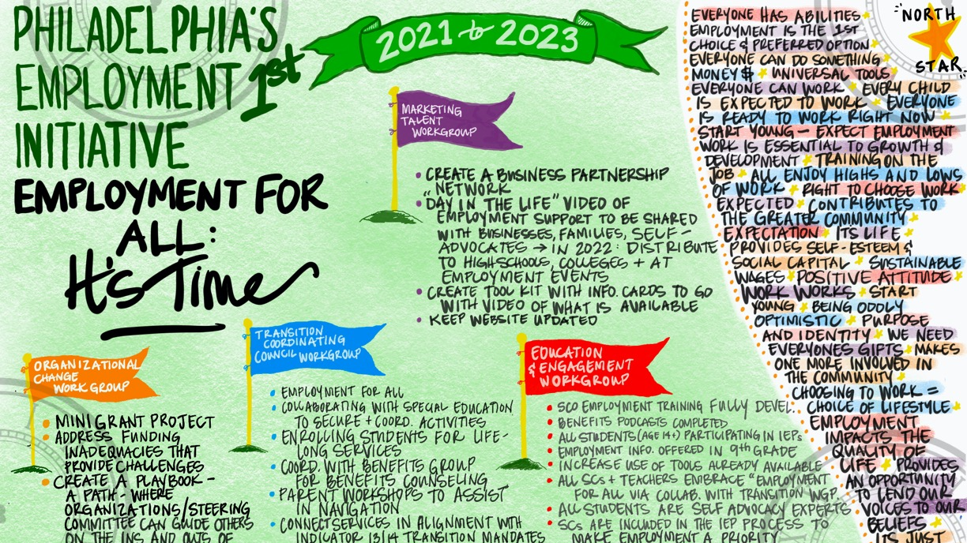
Philadelphia Employment 1st PATH – handouts on table – text version available in app
Notes:
Refer to handouts on the tables of the PATH

Slide 34

2023 – 2025 Strategic Plan
Two-year plan
Theme: Outreach, Connection
Workgroups
  Marketing Talent
  Organizational Change
  Education and Engagement
  Transition Coordinating Council

Slide 35

Let’s Cover Philadelphia:
Outreach
Connection
Inclusion

